Slide 1

Deep learning
Week 7, Lecture 7
Muhammad Saqib Sohail
Fall 2025

Slide 2
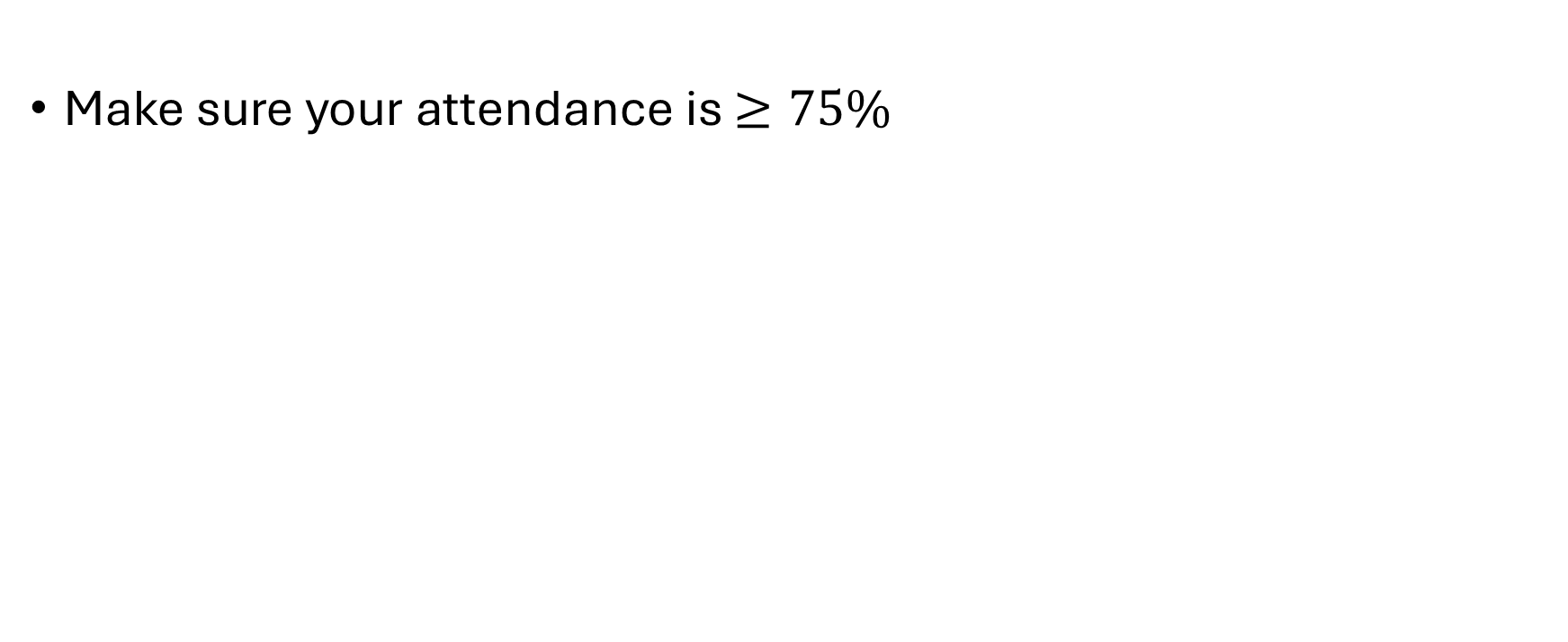
Attendance
Make sure your attendance is $≥75\%$

Slide 3
Landmark CNN Architectures

Slide 4
Influential CNN Architectures
LeNet (1998) → early digit recognition
AlexNet (2012) → breakthrough in ImageNet competition
VGG (2014) → deep network with small 3×3 kernels
ResNet (2015) → solved vanishing gradients with skip connections

Slide 5
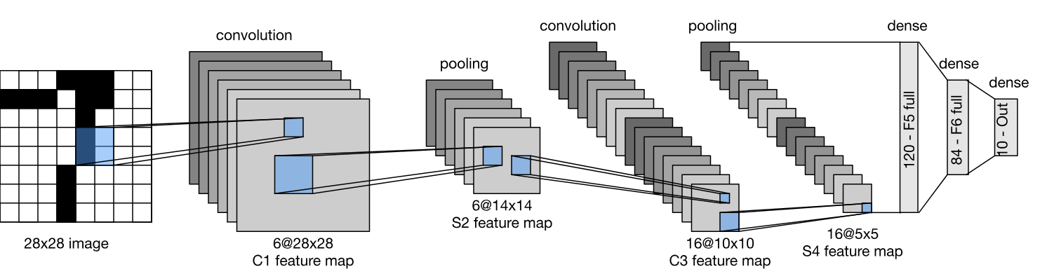
LeNet (1998)
Early CNN for handwritten digit recognition
Developed for the MNIST digit dataset
Architecture:
Conv → Pool → Conv → Pool → FC → FC → Softmax
Used tanh activation and average pooling (not ReLU, not max pooling)
~60k parameters, trained on grayscale 32×32 images
First proof that CNNs can learn spatial hierarchies of features
Key innovation: Introduced the basic CNN building block design
About 60,000 parameters total (conv layer ~49,000, ~11,000 FC layer)

Slide 6
ImageNet: A Game Changer
ImageNet is a massive labelled image dataset
~14 million images, 20,000+ categories (1,000 used for competition)
Hosted annual ImageNet Large Scale Visual Recognition Challenge (ILSVRC)
Standard benchmark for image classification and detection
Encouraged rapid progress in computer vision research

Slide 7
Role in CNN Evolution
In 2012, AlexNet achieved a huge accuracy jump using deep CNNs → shocked the ML community
Sparked a wave of CNN architecture innovations (VGG, GoogLeNet, ResNet etc)
Provided a common ground for fair model comparison and ranking
Models pre-trained on ImageNet became standard for transfer learning in vision tasks

Slide 8
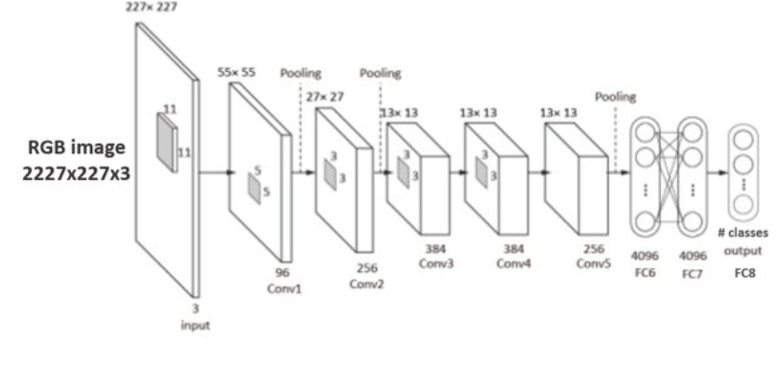
AlexNet (2012)
Parameters:
60 million to 61 million
Conv layer: 3-4 million, FC: 57-58 million
Breakthrough in ImageNet competition
8 layers (5 Conv + 3 FC), 60M parameters
Used ReLU activations (instead of tanh/sigmoid)
Introduced Dropout to reduce overfitting
Used GPU training to handle large computation
Top-5 error on ImageNet dropped from 26% → 15%
Key innovation: Showed that deep CNNs + GPU + ReLU can scale to large datasets

Slide 9
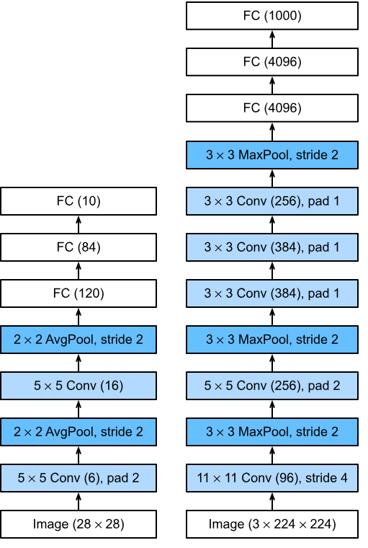
Designs of LeNet and AlexNet
Comparison:
LeNet (left)
AlexNet (right)

Slide 10
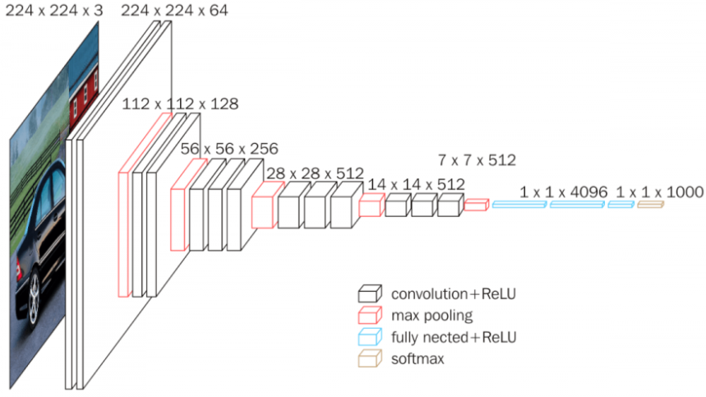
VGG (2014)
Very deep, simple architecture
16–19 weight layers
Stacked 3×3 (filter size) convolutions to achieve deep receptive fields
Used max pooling (2×2) for downsampling
Very uniform architecture, easy to replicate
Very large number of parameters (~138M: Conv layer ~15M, FC layer ~123M)
Key innovation: Showed that depth + small kernels improves performance
The region of the input image that influences the value of a particular neuron (activation) in a feature map

Slide 11
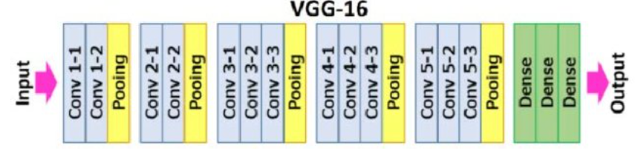
VGG (2014)
ImageNet 2014 with a top-5 error of 7.5%
Every convolution is 3x3, with zero padding
Every convolution followed by ReLU

Slide 12
VGG (2014)
ConvNet is divided into “stages”
Layers within a stage: no subsampling
Subsampling by 2 at the end of each stage
Layers within stage have same number of channels
Every subsampling → double the number of channels
You should be able ot calculate the number of parameters in a given ConvBlock, Given ConvLayer, FC layer, FC block etc.

Slide 13
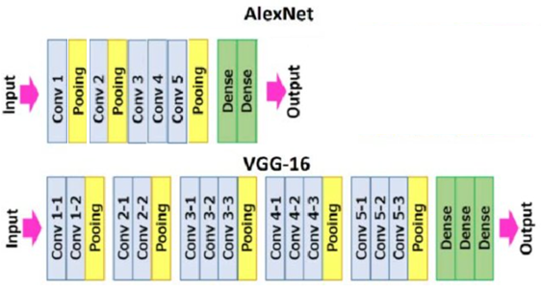
Designs of AlexNet and VGG

Slide 14
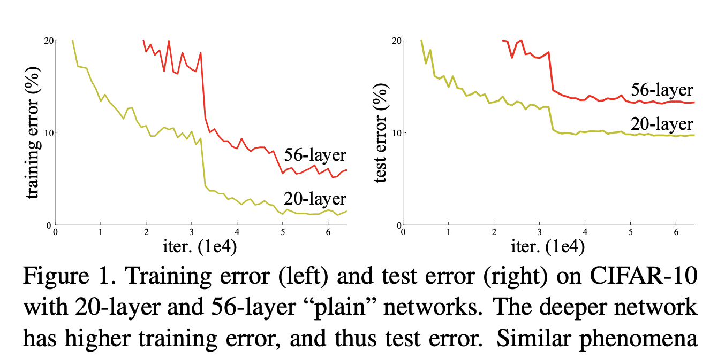
What problem ResNet addressed
Deeper networks should → better representations
But simply stacking more layers led to:
Higher training error (not just test error!)
Optimization difficulty → gradients vanished / exploded
Empirical finding:
20-layer plain CNN trained better than 56-layer plain CNN
Needed a way to train very deep networks effectively

Slide 15
Vanishing gradient problem with ReLU
In deep networks, gradients are backpropagated through many layers
With ReLU, negative inputs → 0 output → 0 gradient
Repeated multiplications by small update terms (Jacobian) → Gradients shrink exponentially
Result:
Early layers learn very slowly
Network fails to converge as depth increases

Slide 16
Residual Networks – ResNet (2015)
Up to 152 layers deep
Introduced skip (residual) connections
Allowed gradients to flow directly across many layers
Solved vanishing gradient problem in deep networks
Won ImageNet 2015 with a top-5 error of 3.57%
Key innovation: Enabled very deep CNNs to train effectively
Inspired later architectures (DenseNet, Transformers…)

Slide 17
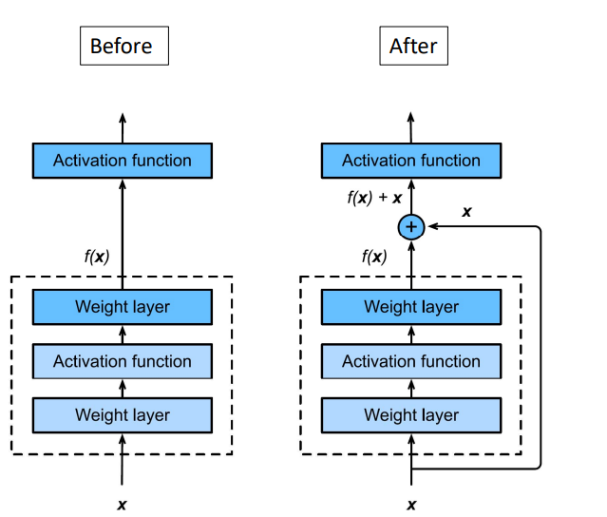
ResNet: Basic idea
Layer output is f(x) + x
Even if f(x) is 0, we have useful signal

Slide 18
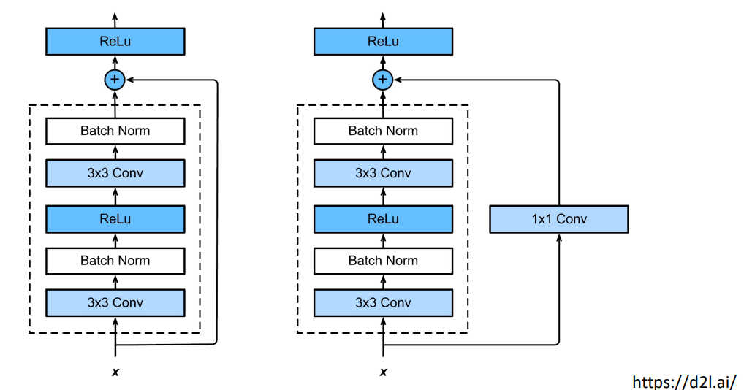
Residual block
When residual block input and out are of same size
When residual block input and out are of different size

Slide 19
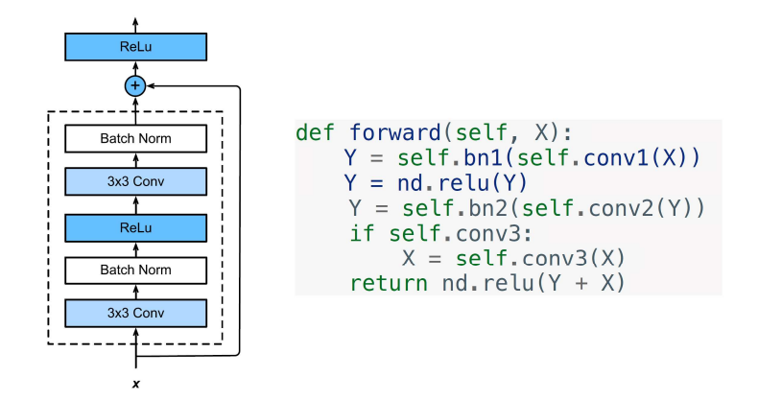
How Residual Block is coded?

Slide 20
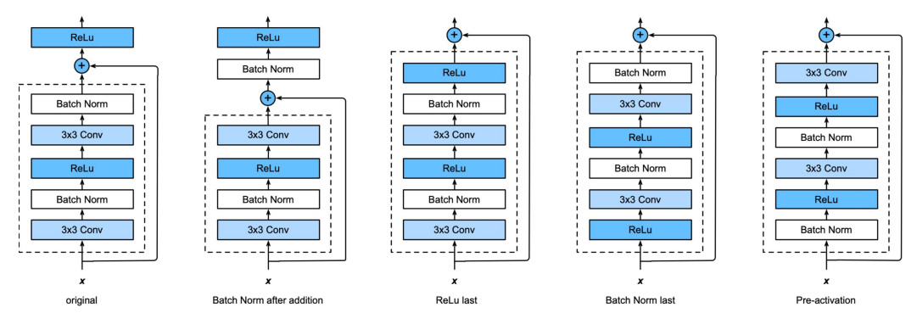
ResNet block flavours: Searching for the best combination
Trial and error of every permutation

Slide 21
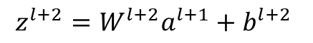

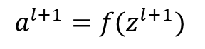
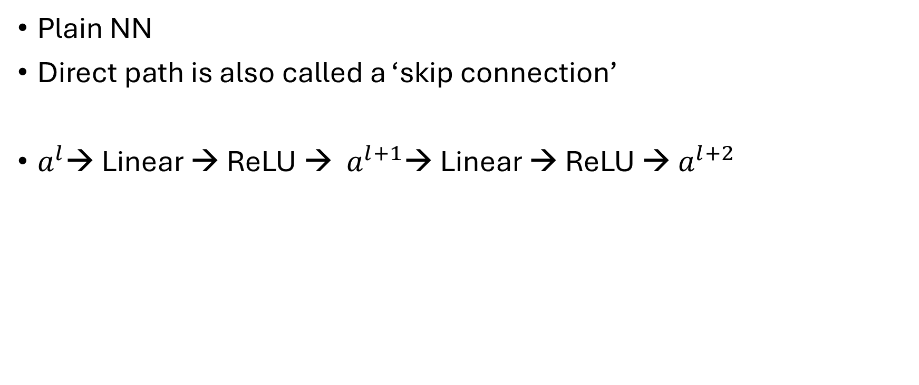
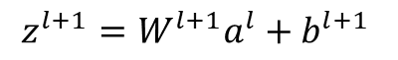



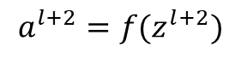
Residual block
$$a^{l+1}$$
$$a^{l}$$
$$a^{l+2}$$
Plain NN
Direct path is also called a ‘skip connection’
$a^{l}$→ Linear → ReLU → $a^{l+1}$→ Linear → ReLU → $a^{l+2}$
$$z^{l+1}=W^{l+1}a^{l}+b^{l+1}$$
$$a^{l+1}=f(z^{l+1})$$
$$z^{l+2}=W^{l+2}a^{l+1}+b^{l+2}$$
$$a^{l+2}=f(z^{l+2})$$
$$a^{l+2}=f(z^{l+2}+a^{l})$$

Slide 22
Basic ResNet Architecture (ResNet 18/34)
Keep it simple, just deep
Design based on VGG style
All 3*3 conv (almost)
Batch normalization and ReLU
Downsampling: cov with stride of 2
Spatial size/2 => # filters *2
No dropout

Slide 23
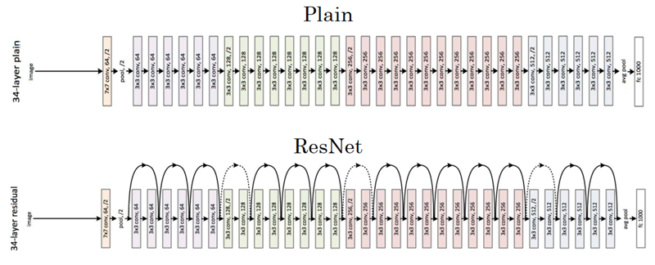
ResNet
3x3 same filters
Strided convolution, Stride=2

Slide 24
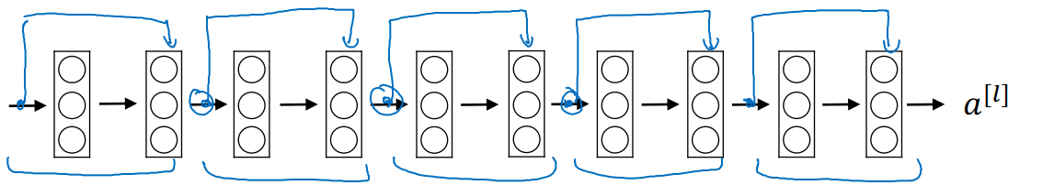
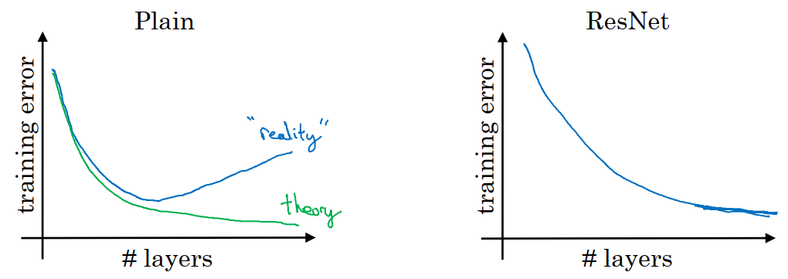
Residual Network

Slide 25
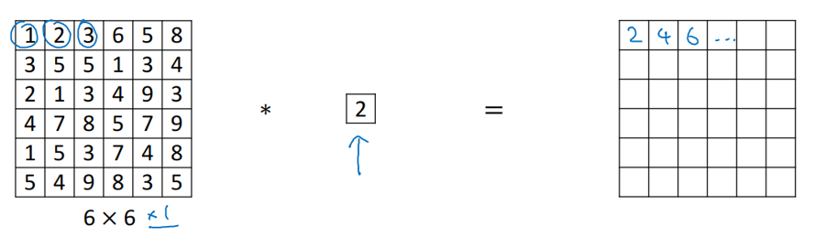
1x1 Convolution

Slide 26
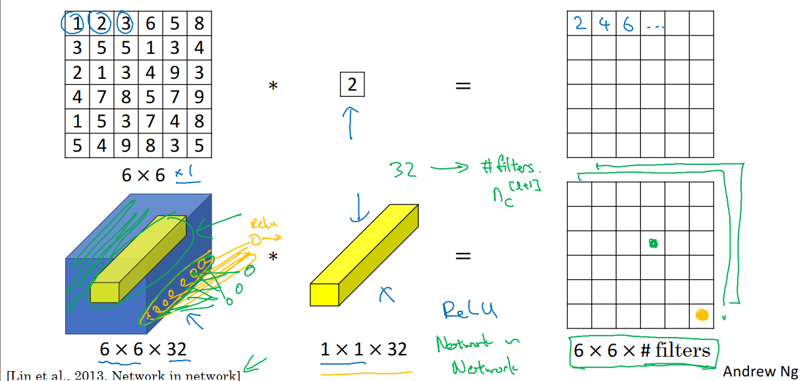
1x1 Convolution

Slide 27
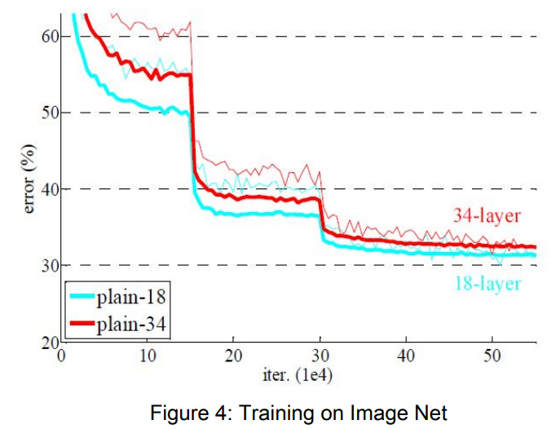
Experiment results: Plain Net
Deeper 34-layer plain net has higher validation error than 18 layer plain net
34-layer plain net has higher training error through the whole training procedure
Degradation problem

Slide 28
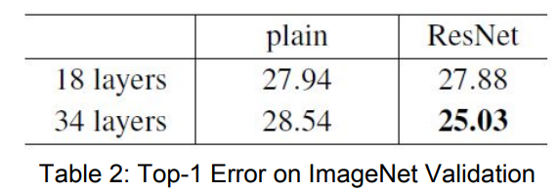
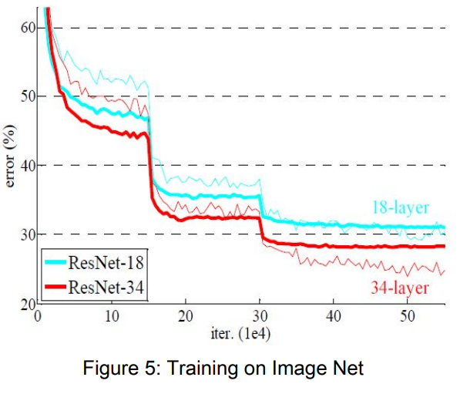
Experiment results: ResNet
34-Layer ResNet is better than 18-layer ResNet (by 2.8%)
lower training error
Degradation problem is addressed
34-layer ResNet reduced top-1 error by 3.5 percent compared to Plain Net
18-layer plain/residual nets are comparably accurate, but…
18-layer Resnet converges faster
ResNet eases optimization by providing faster convergences

Slide 29
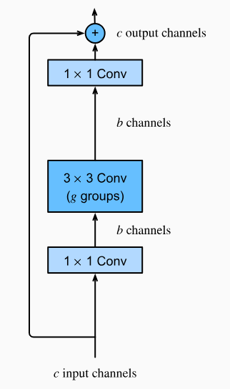
Bottleneck blocks for larger ResNets 50/101/152
Let
c=256
b=64
Regular ResNet
Param. per layer: 3x3x256
Total = 3x3x256 x (num layers )
With Bottlenect block
1x1x256 + 3x3x64 + 1x1x256

Slide 30
Notable architectures
Early / Landmark
LeNet-5
AlexNet
ZFNet
VGGNet
GoogLeNet (Inception v1)
Later notable networks
ResNet (Microsoft)
Inception v2, v3, v4 (Google)
ResNetX (Facebook)
DenseNet
Xception (Google) SqueezeNet

Slide 31
Notable architectures
Lightweight
MobileNet v1, v2, v3 (Google)
ShuffleNet
EfficientNet v1, v2 (Google)
RegNet (Facebook)
ConvNeXt v1, v2 (Facebook)
RepVGG
Modern Hybrid variants
RegNet (Facebook)
RepVGG
ConvNeXt v1, v2 (Facebook)

Slide 32
Recurrent Neural Networks (RNNs)

Slide 33
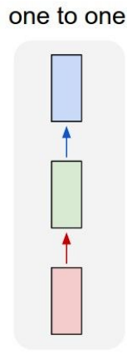
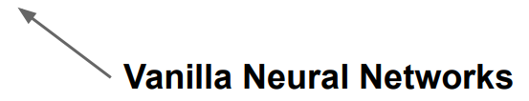
Basic (Vanilla) Neural Network

Slide 34
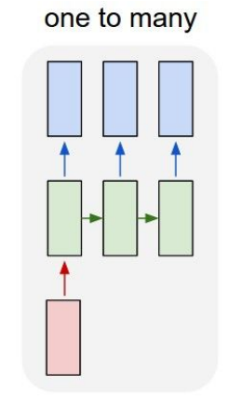
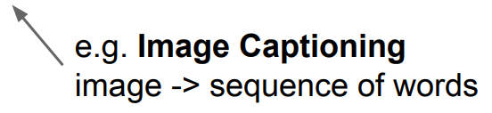
Recurrent Neural Network

Slide 35
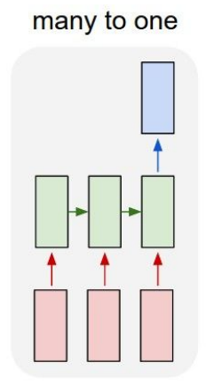
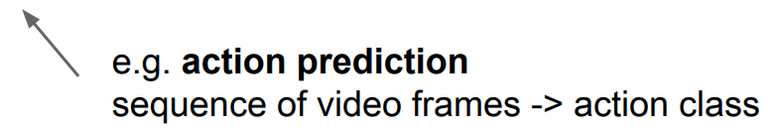
Recurrent Neural Network (Vanilla) Neural Network

Slide 36
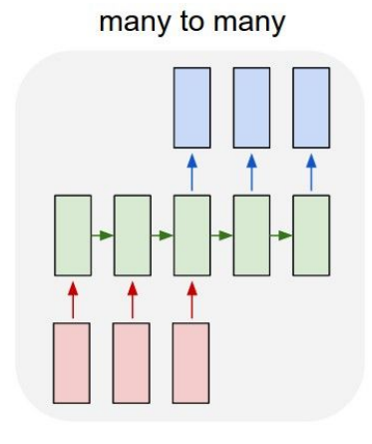
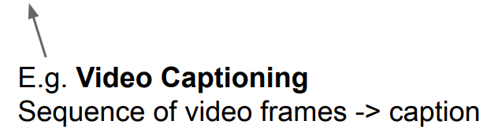
Recurrent Neural Network

Slide 37
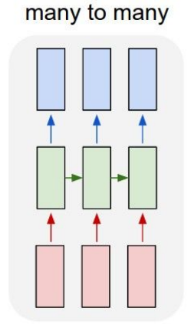
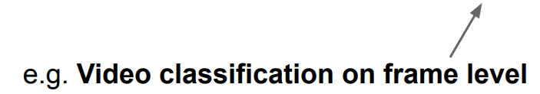
Recurrent Neural Network

Slide 38
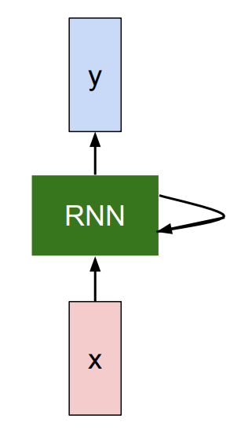
Recurrent Neural Network
Key idea: RNNs have an “internal state” that is updated as a sequence is processed

Slide 39
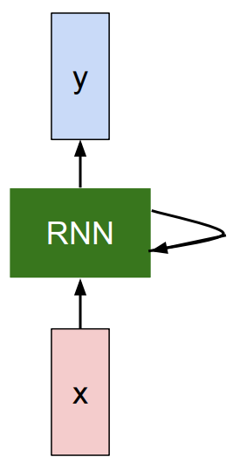
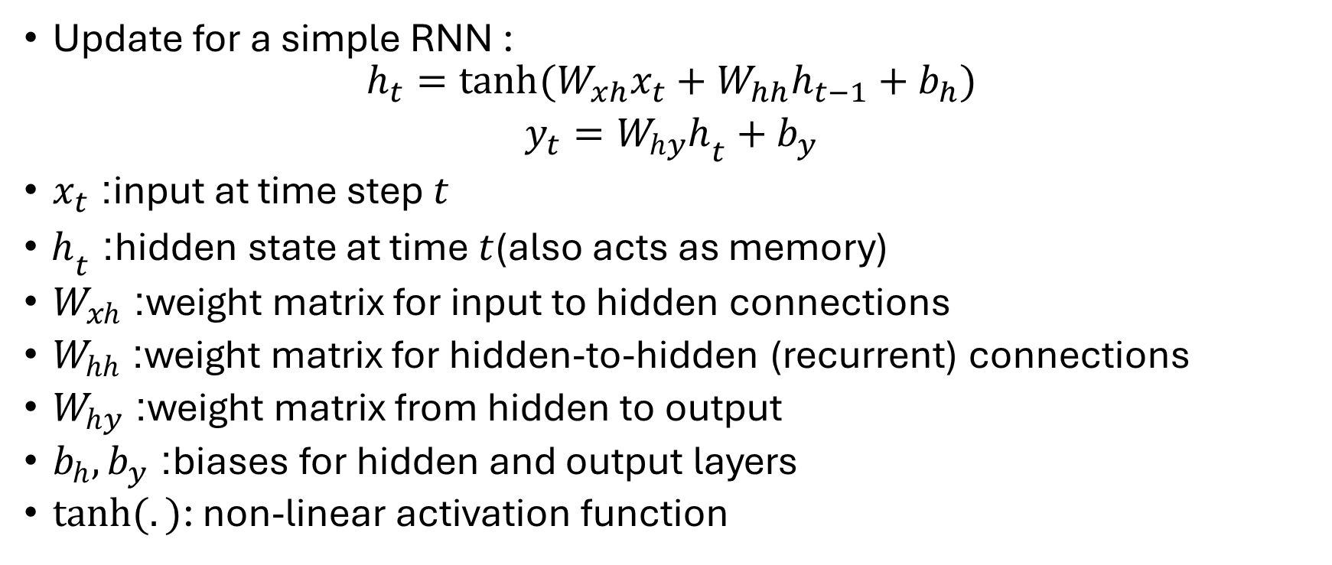
RNN hidden state update
Update for a simple RNN :
$$h_{t}=tanh⁡(W_{xh}x_{t}+W_{hh}h_{t−1}+b_{h})$$
$$y_{t}=W_{hy}h_{t}+b_{y}$$
$x_{t}$: input at time step $t$
$h_{t}$: hidden state at time $t$(also acts as memory)
$W_{xh}$: weight matrix for input to hidden connections
$W_{hh}$: weight matrix for hidden-to-hidden (recurrent) connections
$W_{hy}$: weight matrix from hidden to output
$b_{h},b_{y}$: biases for hidden and output layers
$\tanh{(.)}$: non-linear activation function

Slide 40
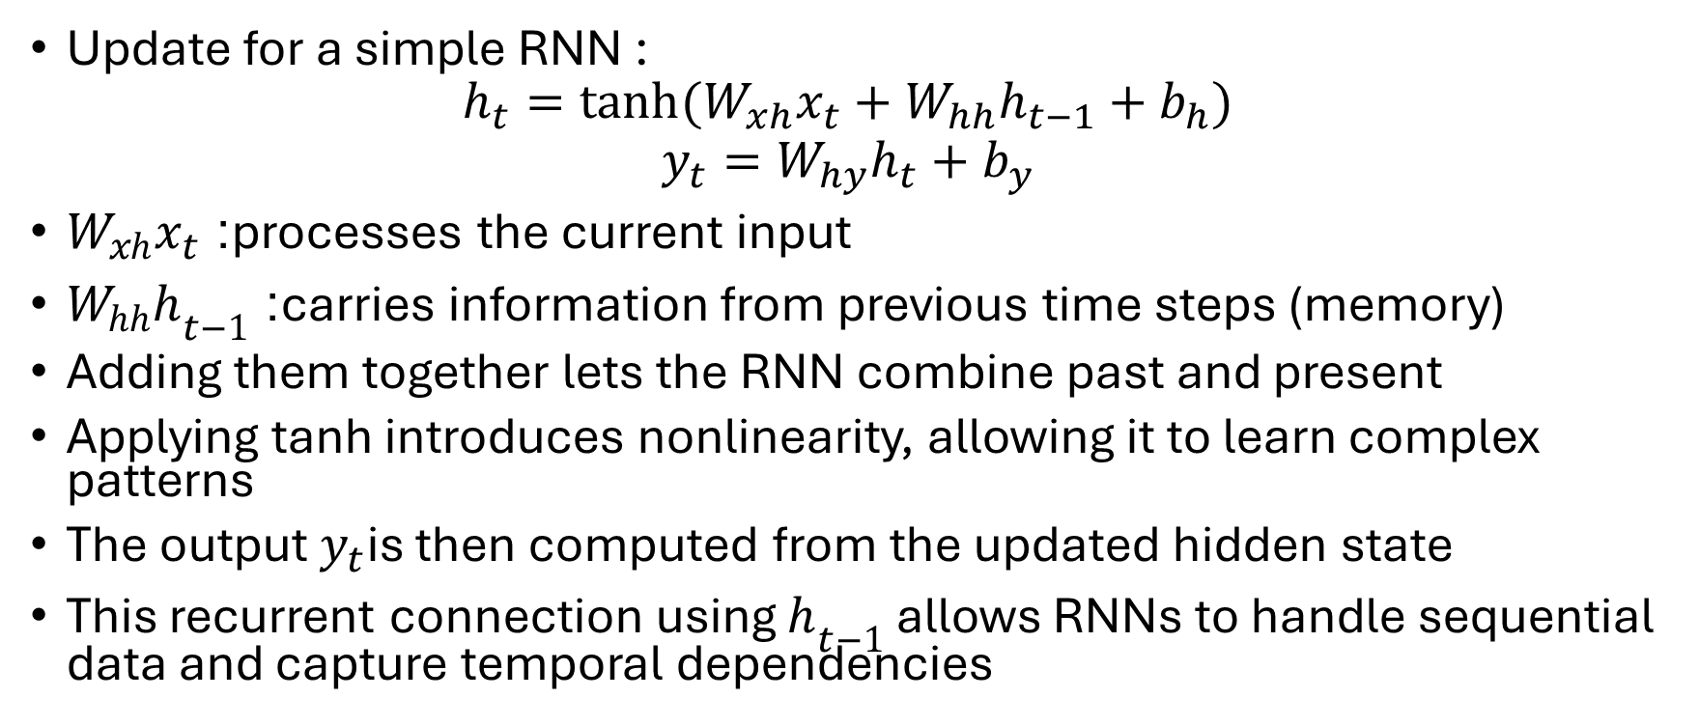
Recurrent Neural Network
Update for a simple RNN :
$$h_{t}=tanh⁡(W_{xh}x_{t}+W_{hh}h_{t−1}+b_{h})$$
$$y_{t}=W_{hy}h_{t}+b_{y}$$
$W_{xh}x_{t}$: processes the current input
$W_{hh}h_{t−1}$: carries information from previous time steps (memory)
Adding them together lets the RNN combine past and present
Applying tanh introduces nonlinearity, allowing it to learn complex patterns
The output $y_{t}$is then computed from the updated hidden state
This recurrent connection using $h_{t−1}$ allows RNNs to handle sequential data and capture temporal dependencies

Slide 41
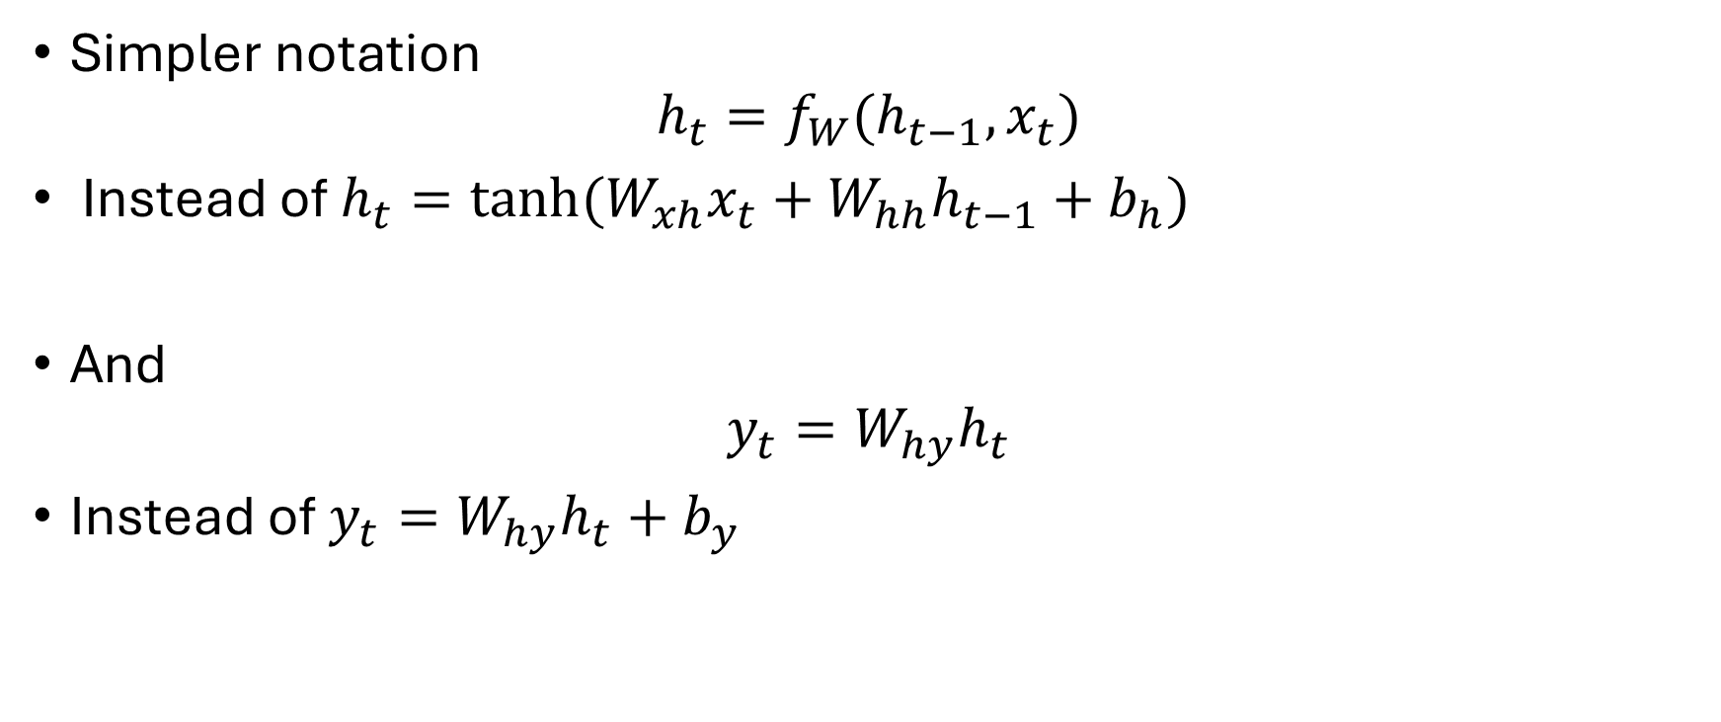
Recurrent Neural Network
Simpler notation
$$h_{t}=f_{W}(h_{t−1}, x_{t})$$
Instead of $h_{t}=tanh⁡(W_{xh}x_{t}+W_{hh}h_{t−1}+b_{h})$
And
$$y_{t}=W_{hy}h_{t}$$
Instead of $y_{t}=W_{hy}h_{t}+b_{y}$

Slide 42
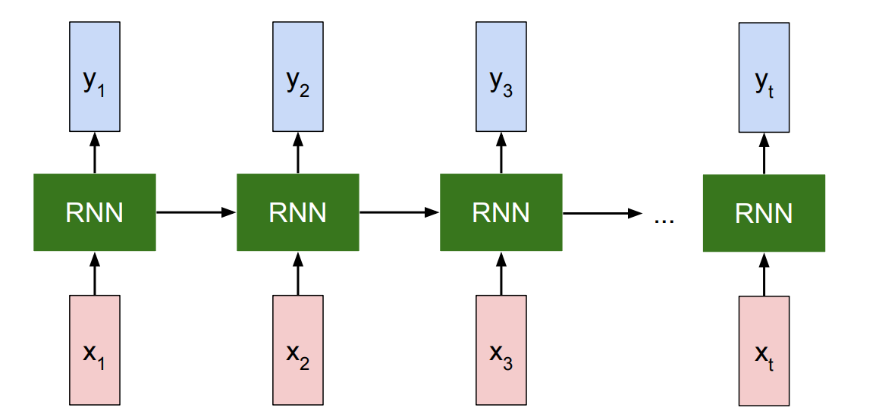
Recurrent Neural Network
Unrolled RNN

Slide 43
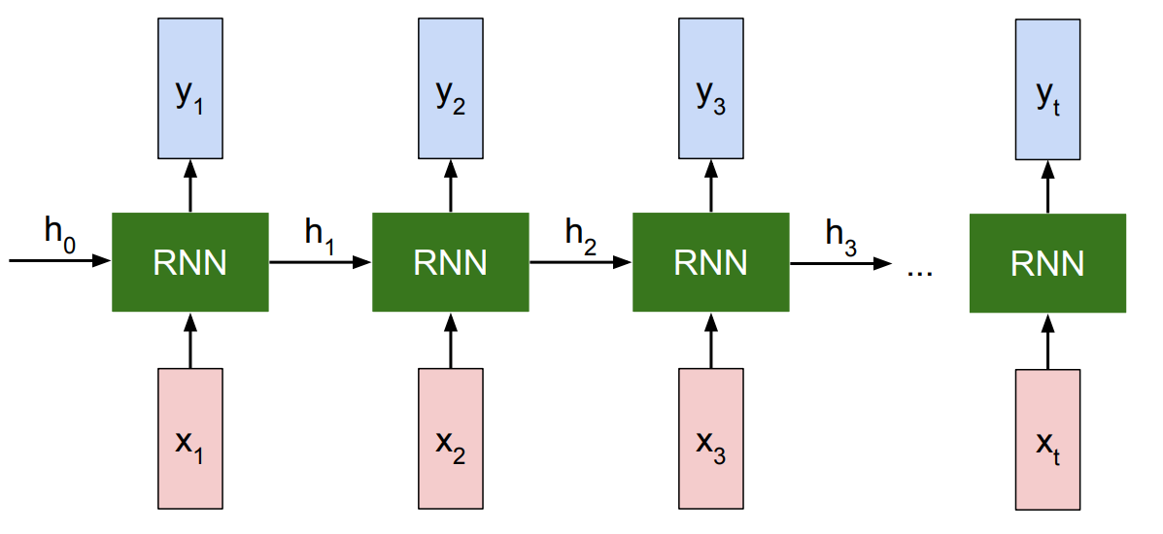
Recurrent Neural Network
Unrolled RNN

Slide 44
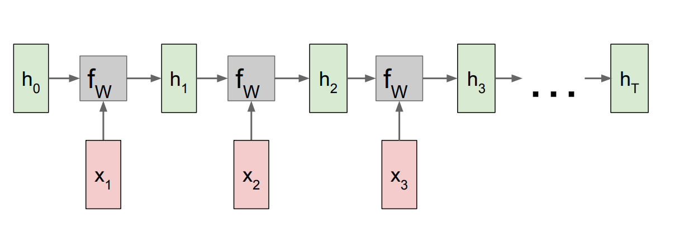
Recurrent Neural Network

Slide 45
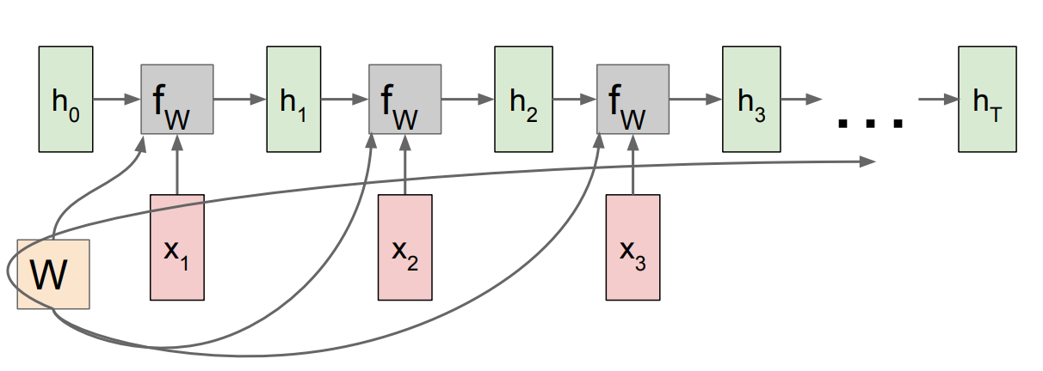
Recurrent Neural Network
Re-use the same weight matrix at every time-step
Backpropogation: a separate gradient for W flows from each time step and total gradient is the sum of all of those

Slide 46
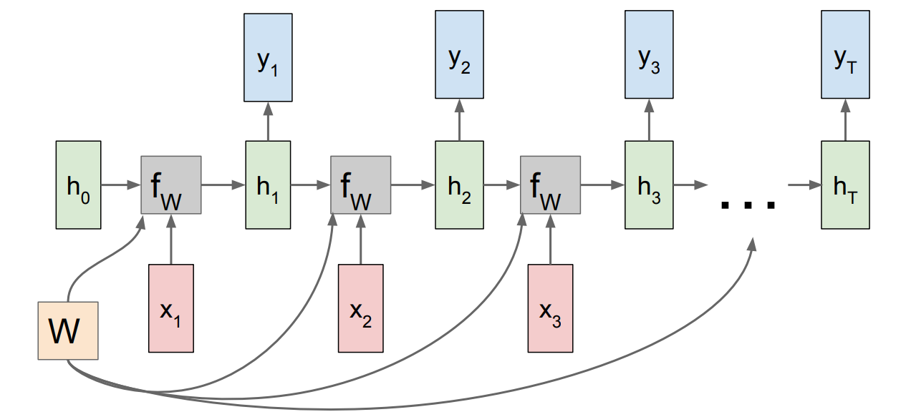
RNN: Many to many
The h’s can feed to a separate NN to output y’s

Slide 47
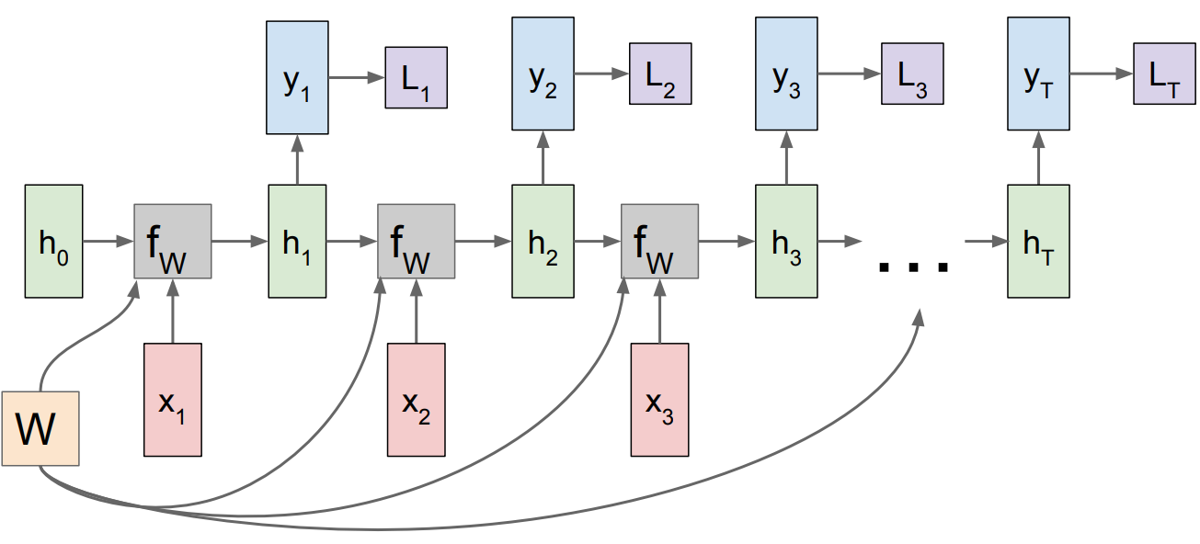
RNN: Many to many
Loss computed at every time step

Slide 48
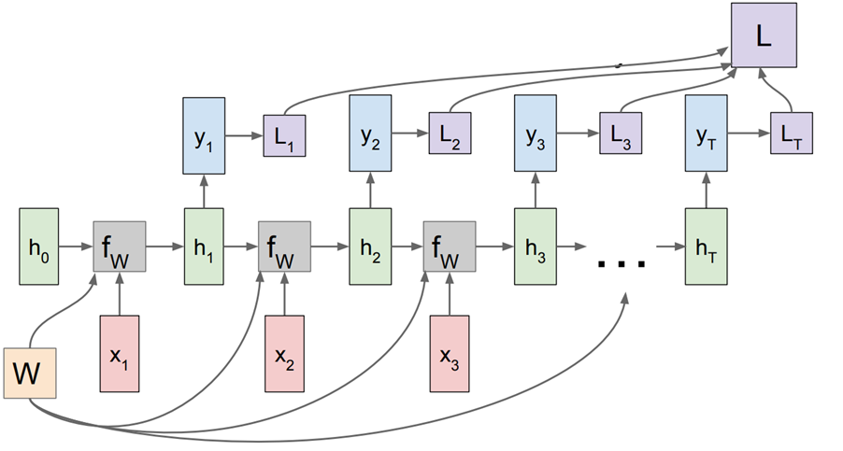
RNN: Many to many
Final loss is the sum of all Losses computed at each time step
One option: W is updated once per a sequence of input (e.g., after the entire input sentence has passed through the network)

Slide 49
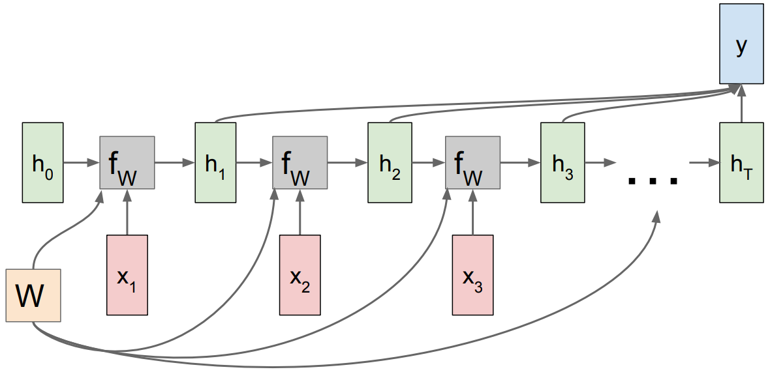
RNN: many to one

Slide 50
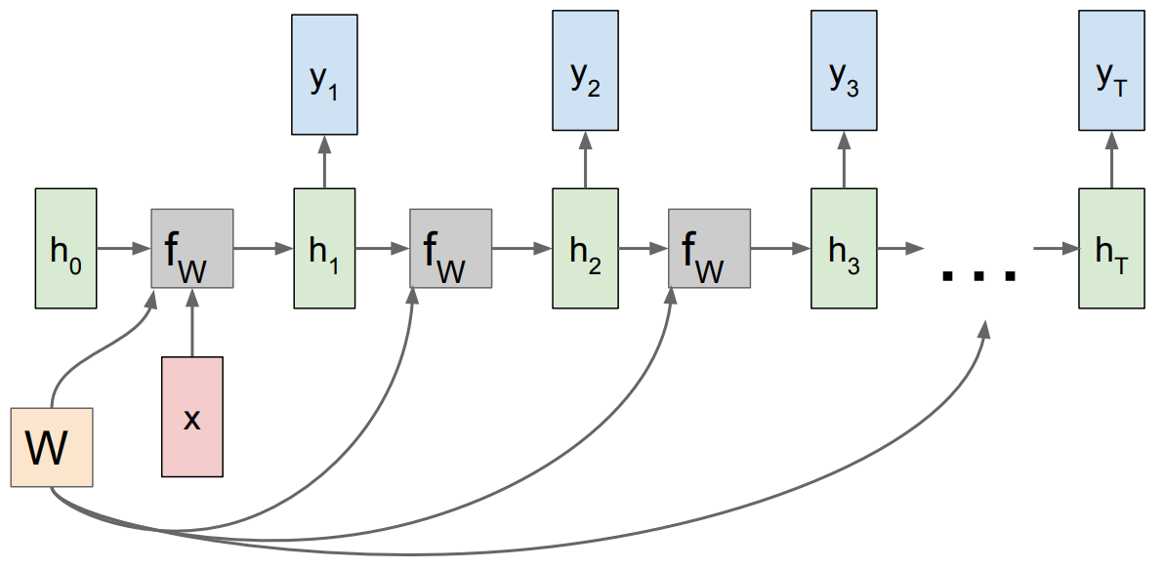
RNN: one to many

Slide 51


Sequence to Sequence: Many-to-one + one-to-many
One to many: Produce output sequence from single input vector
Many to one: Encode input sequence in a single vector
Encoder
Decoder
Encoder translates the input sentence to a vector

Slide 52

Example: Character-level Language Model
Vocabulary: [h,e,l,o]
Example training sequence: “hello”

Slide 53


Example: Character-level Language Model
Vocabulary: [h,e,l,o]
Example training sequence: “hello”

Slide 54

Example: Character-level Language Model
Vocabulary: [h,e,l,o]
Example training sequence: “hello”

Slide 55

Example: Character-level Language Model
Vocabulary: [h,e,l,o]
At test-time sample characters one at a time, feed back to model

Slide 56

Example: Character-level Language Model
Vocabulary: [h,e,l,o]
At test-time sample characters one at a time, feed back to model

Slide 57

Example: Character-level Language Model
Vocabulary: [h,e,l,o]
At test-time sample characters one at a time, feed back to model

Slide 58

Example: Character-level Language Model
Vocabulary: [h,e,l,o]
At test-time sample characters one at a time, feed back to model

Slide 59

RNN: Loss computation

Slide 60

RNN: Loss computation
Truncated loss computation - Run forward and backward through chunks of the sequence instead of whole sequence

Slide 61

RNN: Loss computation
Carry hidden states forward in time forever, but only backpropagate for some smaller number of steps

